Slide 1
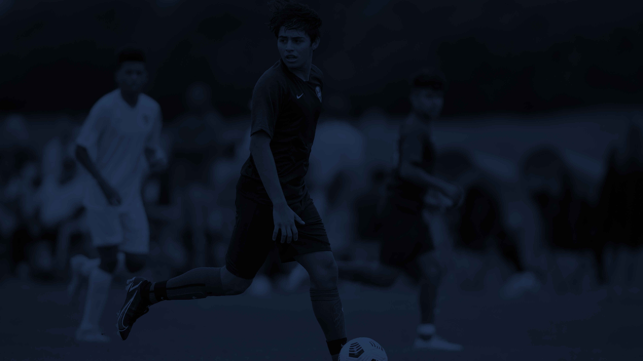



Idaho ODP
Town Hall
#WEAREYOUTHSOCCER

Slide 2

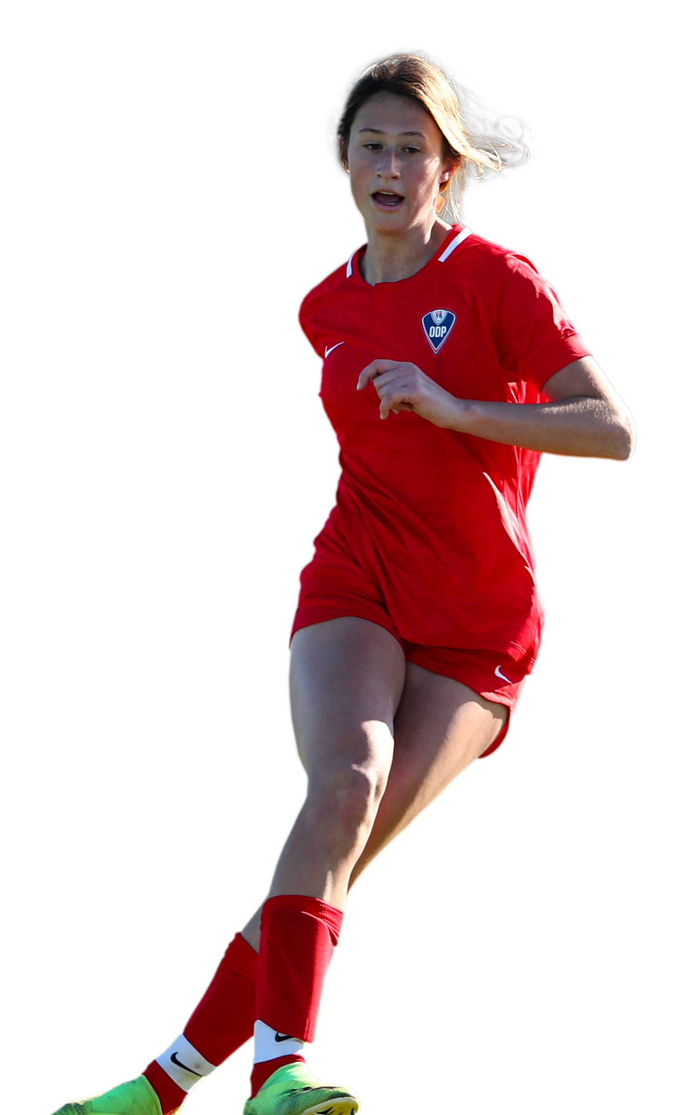
Idaho ODP Town Hall
2026-2027 Season Overview
Join Idaho's Team
Program Overview
Tryouts & Selection Process
RTC Pools & State Select Teams
Coaching Staff
Season Calendar
Events & Travel
International Opportunities
Team Managers
Questions & Answers

Slide 3
Program Overview
The Idaho Olympic Development Program (ODP) provides players opportunities to:
Train with top players from across Idaho
Work with coaches from different clubs and environments
Compete in regional and national pathways
Attend identification events
Access regional, interregional, national, and international opportunities
Represent Idaho at the highest levels of youth soccer

Slide 4

International Opportunities
Idaho ODP International Experiences
• Open to all ODP Players
• Separate Registration Process
• Additional Development Opportunity
Potential Opportunities
• Spain – Boys March 2027
• Brazil – Girls Summer 2027
Travel and educational programming provided in partnership with WorldStrides.

Slide 5
Tryouts & Selection Process
2026 Tryout Format:
• Two-day evaluation process
• Morning and afternoon field sessions
• Goalkeeper-specific session (between sessions)
• Independent evaluators and coaching staff
• Official tryout shirt included
• Player number assignment
Tryouts held at Regional Training Center Locations
• Southwest Idaho (Boise): July 18 & 19
• East Idaho (Idaho Falls): July 25 & 26
• North Idaho (Coeur d' Alene): August 1 & 2
Supplemental Tryouts (Boise): August 7 & 9
All information including field numbers, session times, and more will be emailed to completed tryout registrants and incomplete registrations.

Slide 6
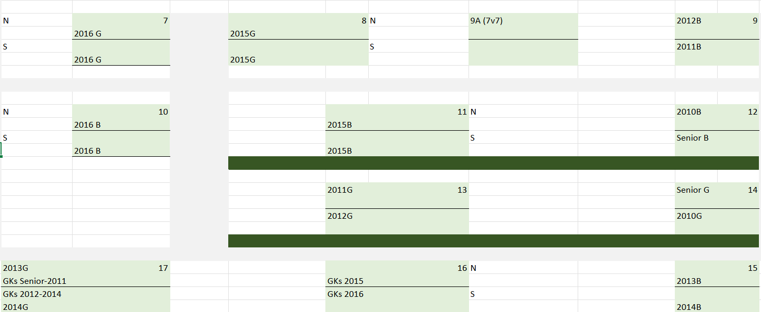
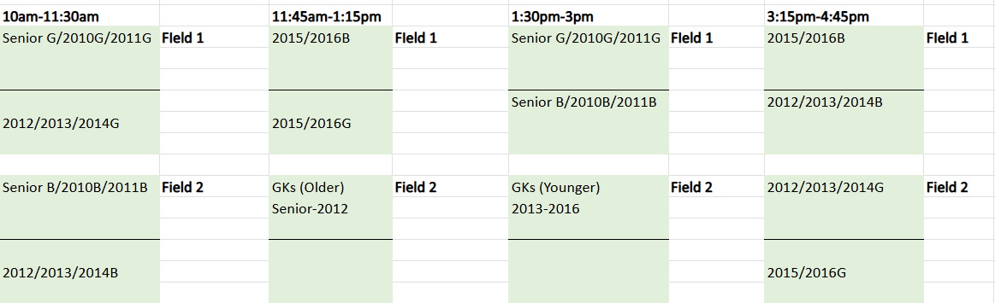
Tryout Process Continued
Boise RTC Schedule: All Age Groups at Same Time
Morning Session: 10am – 11:30am
Goalkeeper Session: 11:45am – 1:15pm
Afternoon Session: 1:30pm-3:00pm
North/East RTC Schedule: Split Age Groups
Morning Session: 10am – 11:30am (11v11 Ages)
Morning Session: 11:45am-1:15pm (9v9 Ages)
Goalkeeper Session: 11:45am – 1:15pm (Older)
Goalkeeper Session: 1:30-3:00pm (Younger)
Afternoon Session: 1:30pm-3:00pm (High School Ages)
Afternoon Session: 3:15pm-4:45pm (2012-2016 Ages)

Slide 7
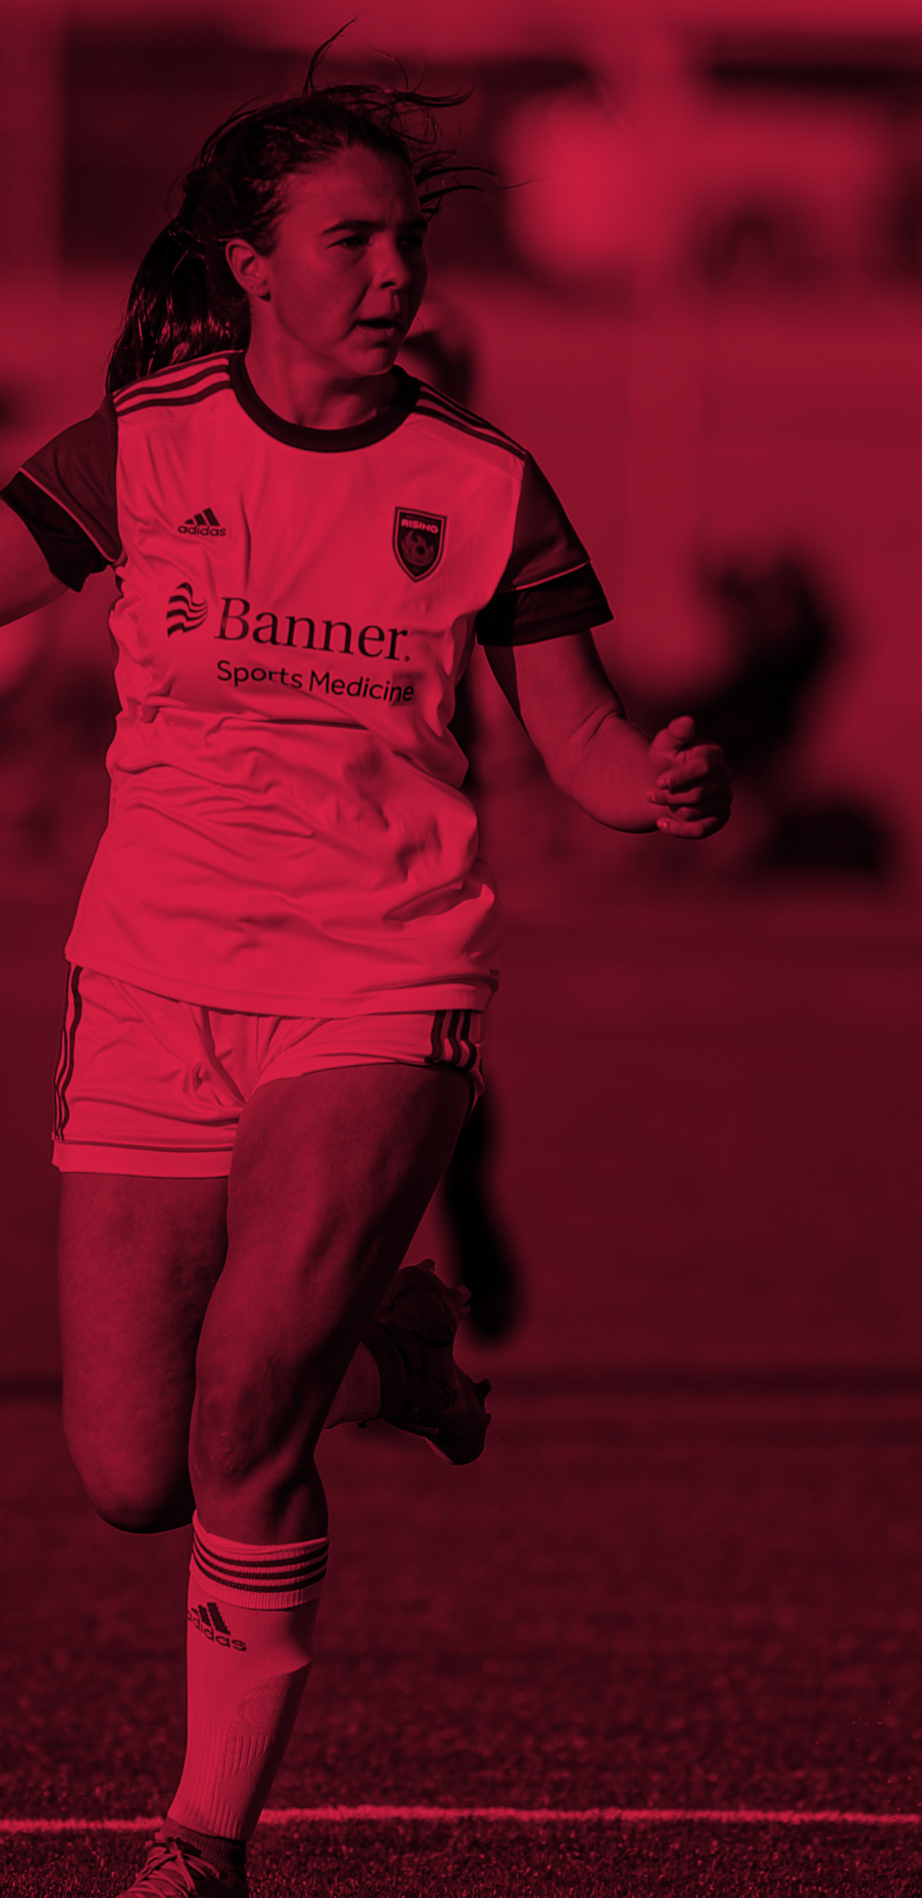
Player Selection Criteria
What We Are Looking For:
Technical Ability & Understanding
Athleticism
Competitiveness
Coachability
Character & Attitude
Players are evaluated by independent coaches/evaluators throughout tryouts and training to ensure a fair and unbiased selection process.
Player Pools
66-player pool (11v11) – 22 players per region
45-player pool (9v9 Pre-ODP) – 15 players per region
Selection & Timeline
Players are notified after tryouts and supplemental tryouts (Aug 7 & 9). Final rosters are confirmed by late August, with acceptance in September ahead of training start (Oct for younger / Nov for older).
State Select Teams
From each pool, State Select Teams are formed:
11v11: Approx.. 18 players
9v9: Approx.. 15 players
2 travel tournaments: ODP Championships, AZ & ODP Interregional Showcase, TN

Slide 8
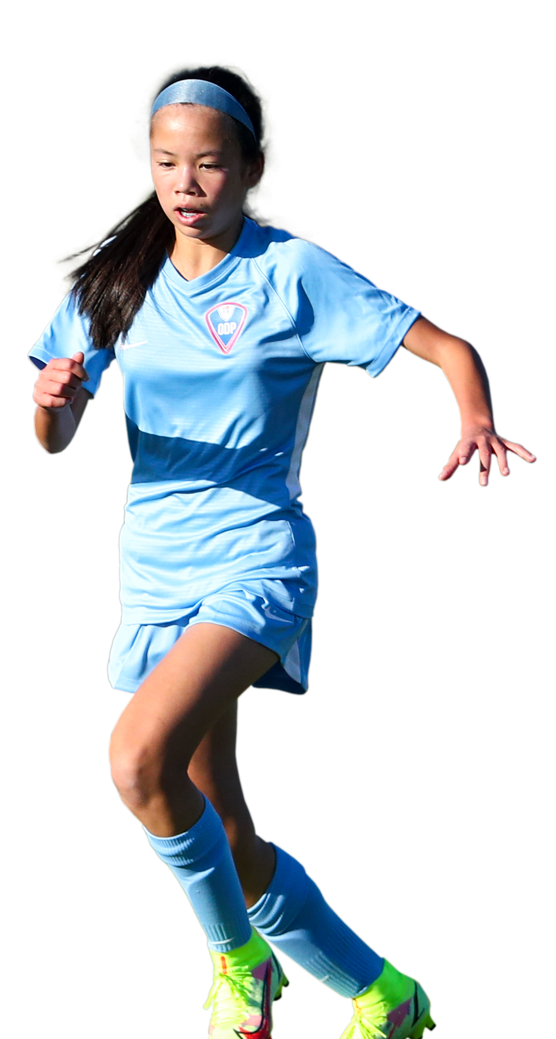

RTC Pool vs State Select Team
RTC Pool
Included in Program Registration
$800 (ODP) | $500 (Pre-ODP, Senior Team, North/East RTC Players)
• Training Sessions
• Pool Identification Events (Friendlies)
• Ongoing Player Evaluation including Development Workshops and Webinars
• Opportunity for State Team Selection
State Select Team
Additional Event Fee (Each Event) - $300
Regional Events: ODP Championships, AZ & ODP Interregional Showcase, TN
• Team Travel
• Hotel Accommodations
• Team Meals
• Ground Transportation
• Event Registration
State Select Teams are selected from the RTC player pools from ongoing monitoring throughout the season.

Slide 9
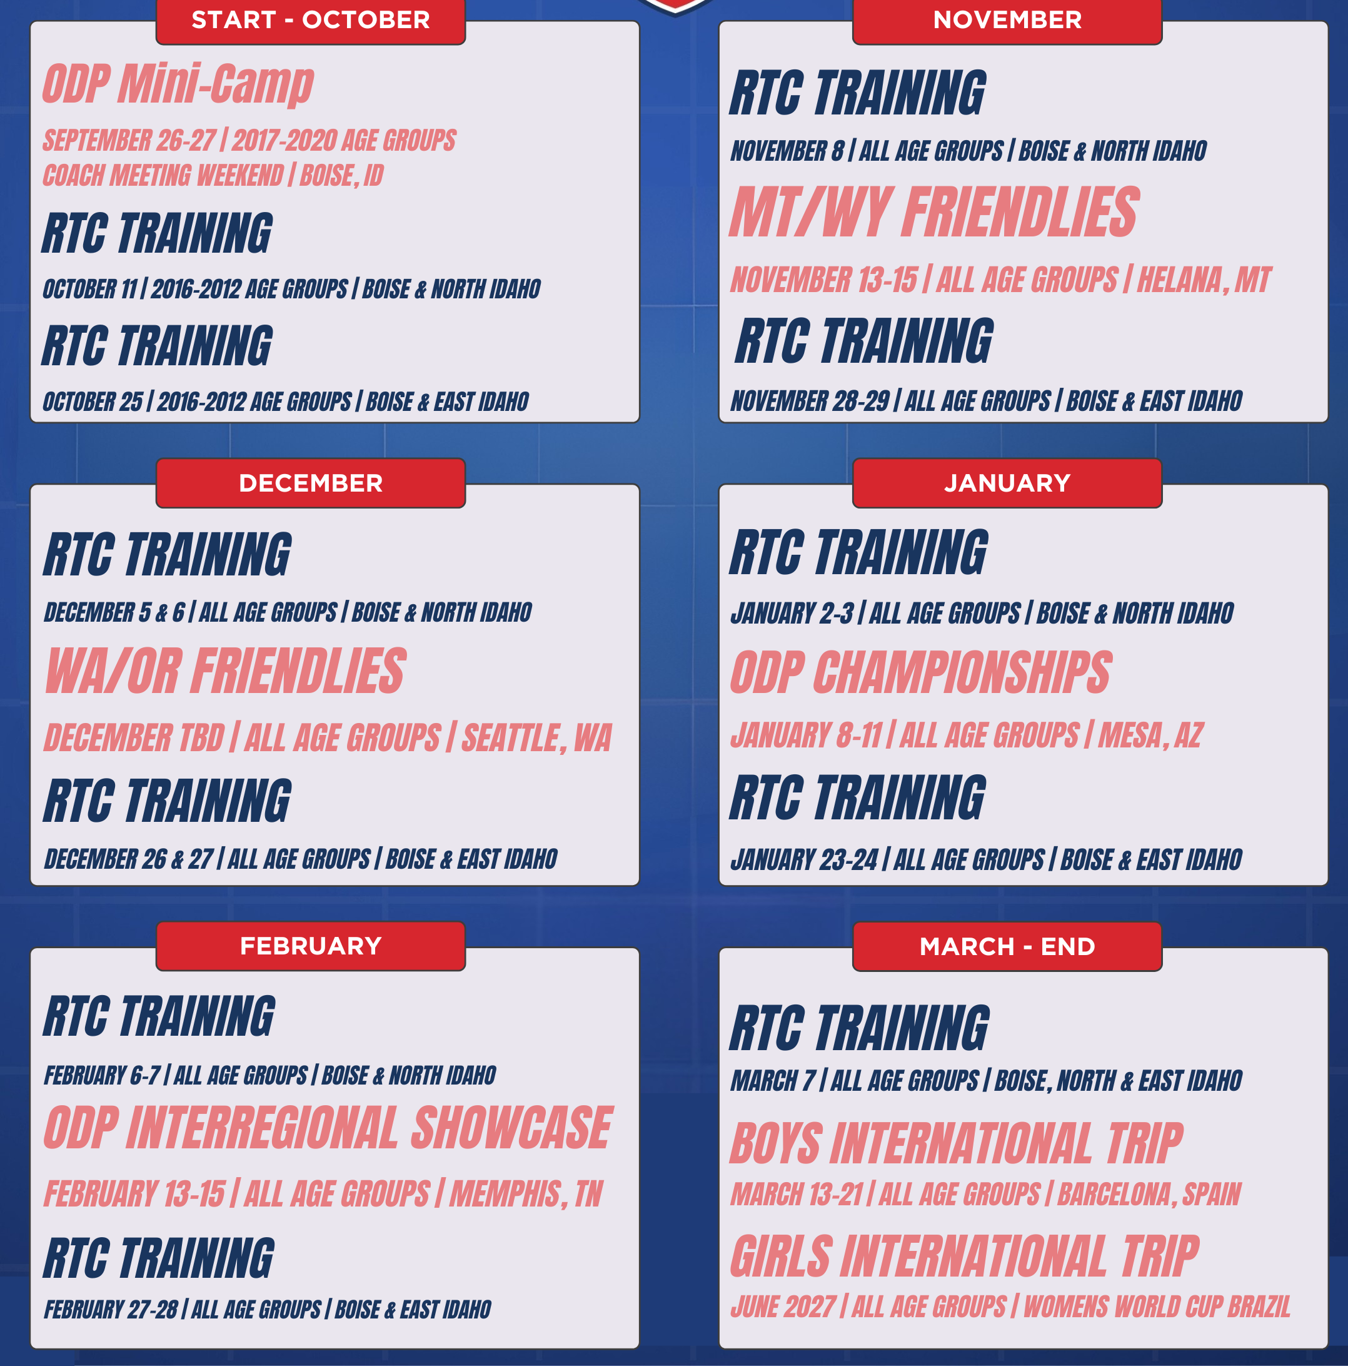
2026-2027 Calendar
• Tryouts
• Eleven (11) Monthly RTC Trainings
• Two (2) Friendlies
• Two (2) Regional Events
• International Opportunities (Boys & Girls)
ODP Mini-Camp for 2017-2020 Age Groups
Coach Onboarding & Startup Weekend

Slide 10
ODP Senior Team Schedule
Statewide Player Pool for 08/09 Boys and 08/09 Girls
Monthly Trainings
Two Tournament Showcase Events
  Mayors Cup: February 2027
  Desert Cup: November 2026
  Identified by Senior Team Coaches and Communicated by TA
Two College Training Friendlies
  Girls Last Year: College of Southern Idaho, Blue Mountain Community College
  Boys Last Year: College of Idaho, Walla Walla Community College, North Idaho College, Walla Walla University

Slide 11
Coaching Staff
65 Coaches Total
26 RTC & 5 Goalkeeper Coaches
Boise Pool Coaches (36)
16 Head Coaches
20 Assistant Coaches
3 Goalkeeper Coaches (Olders, Youngers, Pre-ODP)
North/East (13 each RTC)
12 total. Four (4) coaches working with each age group cluster split between boys and girls
  Older: 2008/2009-2011
  Younger: 2012-2014
  Pre-ODP: 2015-2016
1 Goalkeeper Coach at each Region
Coaching Staff to be released before tryouts, by the end of June

Slide 12
Program Ops
Travel & Logistics
Idaho ODP Will Coordinate:
• Earlier travel planning and bookings for hotel accommodations using Traveling Teams
• Streamlined communication
• Team meal coordination through EZ Cater / Team Mealz

Slide 13


Team Managers
Each Age Group Team Is Expected To Have A Team Manager
Responsibilities
• Team Communication
• Travel Coordination
• Roster Management
• Family Support
• Event Logistics
Benefits
• 25% Program Registration Discount Per Event (4)
• Travel expenses not included
Team Managers play a critical role in creating a positive experience for players and families.

Slide 14
ODP Pathway & Highlights
Idaho ODP Pathway
Idaho ODP
Far West Championships
West Region Summer ID Camp
ODP Interregional Camp
National ODP Team
International Competition
Congratulations to our 2025-2026 National ODP Team Players:
• Mason Boggs
• Stella Jones
• Amuza Shanti
• Adrian Lowe
• Elijah Grimaldo
Idaho ODP By The Numbers
2025/2026 Cycle Highlight
• 420+ Players
• 40+ Coaches
• 3 RTC Locations
• 5 National ODP Team Selections
• 12 Interregional Team Selections
Continuing to grow opportunities for players and coaches across Idaho.

Slide 15
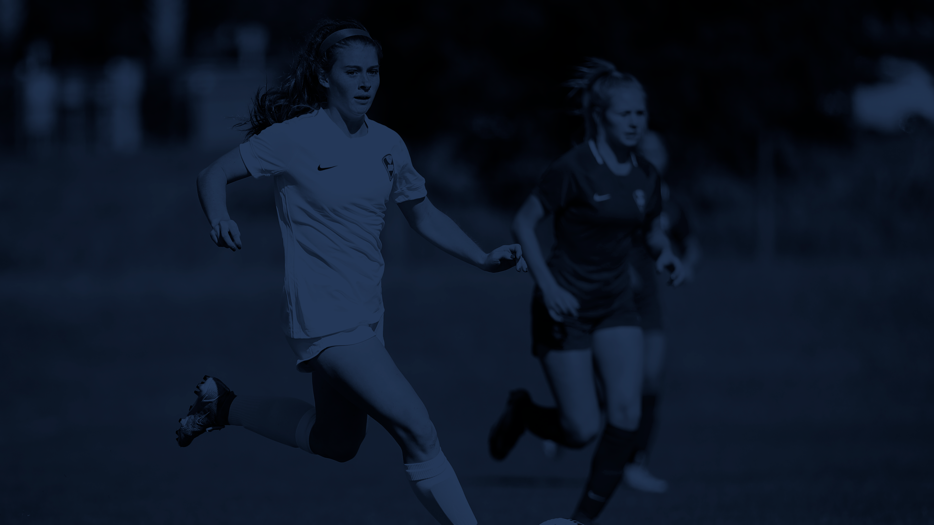
THANK YOU
Q&A starting from the chat then proceeding to raised hands.

