Slide 1
IDAHO STATE LEAGUE
2023/24 Format

Slide 2
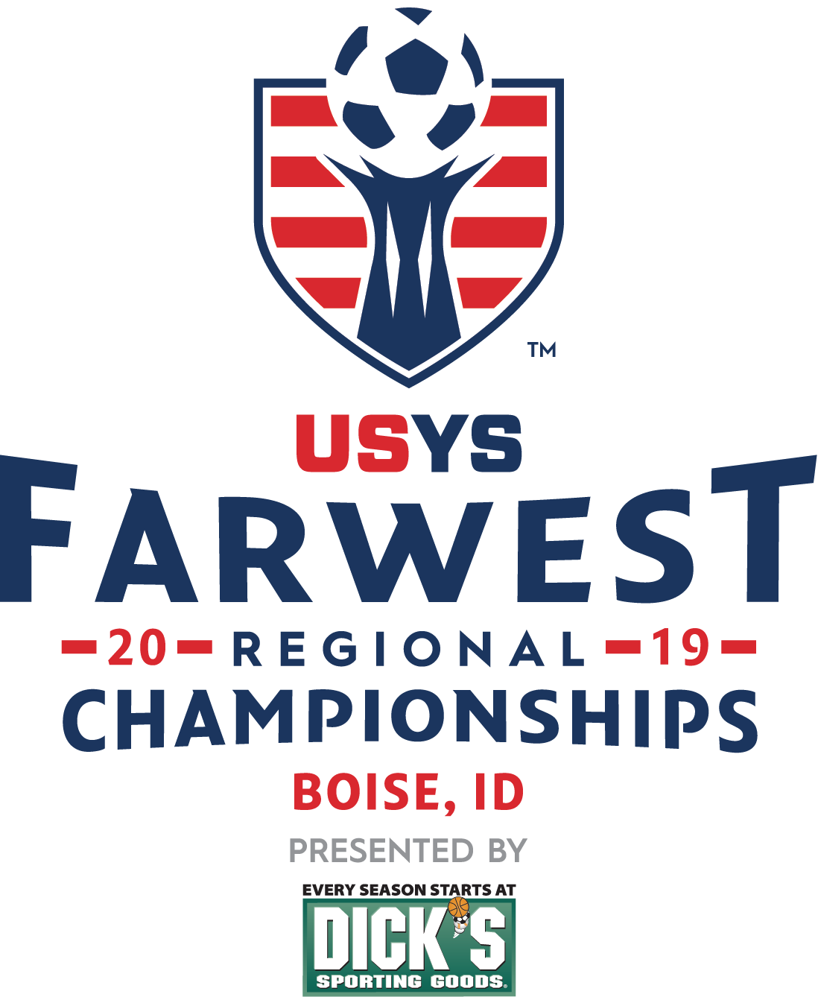
FORMAT
TOP 4 COMPETE
IN SEMI-FINAL / FINAL FOR STATE CHAMPIONSHIP
Round Robin Play dates

Slide 3
TEAM FORMAT
U12 – U17 age groups
U18/U19 would play just on Directors Cup weekend
U12 9v9 age group format (advancing to U12 Regionals hosted during Presidents Cup)
6- 8 Team age group format
RR format playing each opponent over the course of 3 or 4 play dates
Top 4 points advance to semifinal/final weekend (1v4 2v3)
Other age group exceptions TBD by TAC and outlined in ISL rules

Slide 4
QUALIFYING U13 – U18*
Automatic qualifier eligibility will come from IYSA hosted year end State Cup and Directors Cup events.
Final 4 for 2023 State League is AQ (Automatic Qualifier) for next year's league
Directors Cup winner in Gold division is AQ for next year's league
5th place for 2023 State league for the 23/24 Season will receive free entry to Directors Cup 2024.
Remaining state league teams wishing to participate in Directors Cup 2024 will pay entry fee but be guaranteed entry.

Slide 5
U12 Qualifying
For the 2024 Season and beyond
1st – 4th place at U11 Gold Bracket from Directors Cup will receive AQ (Automatic Qualifier) spots for the following year's State league.

Slide 6
Schedule 2024 Dates
Play dates U12 – U14
Round Robin Rounds (Likely will only need to play 3 of 4 dates)
1st play date September 29- Oct 1
2nd play date October 13-15
3rd play date March 15-17 -
4th play date April 12- 14
Semi Final/Final Weekend – April 26-28
Play Dates U15 – U17*
1st Play date November 11/12 play in games for non-seeded teams*weather permitting (Eastern Idaho Potential Host)
2nd Play date March 16/17 - Play in games if November 11/12 weekend unplayable, games as needed to complete RR play
3rd Play date April 13/14 - quarterfinals play in games winners vs seeded teams from 2022 ISL
Semi Final/Final Weekend - April 26-28
U18/U19s – Directors Cup weekend tournament – 18/19s will be a combined age group bracket at the regional level events, so we will do the same.

Slide 7
LOCATION
BOISE BASED GAMES
If 2 teams from same area want to play at alternate date and time in lieu of 3rd game on one weekend.
Must be communicated and agreed to by both teams and State TD
District 1 vs District 2/4 will always be in Boise because no direct route to either place.
If District 1 or District 2/4 has two teams in the same age group and gender, they are eligible to host for that set of games.
Weather related changes

Slide 8
HOW MUCH IS THE LEAGUE ENTRY FEE?
COST IS HEAVILY DETERMINED BY THE ESTIMATED NUMBER OF PARTICIPANTS AND THE FORMAT OPTION
 | COST
U12 - U14 | $1200.00
U15 - U19 | $875.00
Includes entry fee to West Regionals, West Presidents Cup
Includes referee fees
Includes Awards
Includes field costs

Slide 9
TAC and Appeals Members
Technical Advisory Committee
Technical Director
3 members District 3
1 member District 1
2 members District 2/4
Appeals and Discipline Committee
ED
TD
2 Members from TAC chosen by TD
ISRC Committee Member

